Slide 1


Slide 2


Human Disease Detector
Second Year Project Synopsis
Submitted by
ROLL | NAME
Jyoti | 2301730172
Paridhi Chahal | 2301730186
Akshat Gupta | 2301730170
Jatin Rawat | 2301730155
Industry Mentor: Ms Shikha
Faculty Mentor: Mr Rahul Singh
Notes:
New Courses replaced with New Programmes

Slide 3
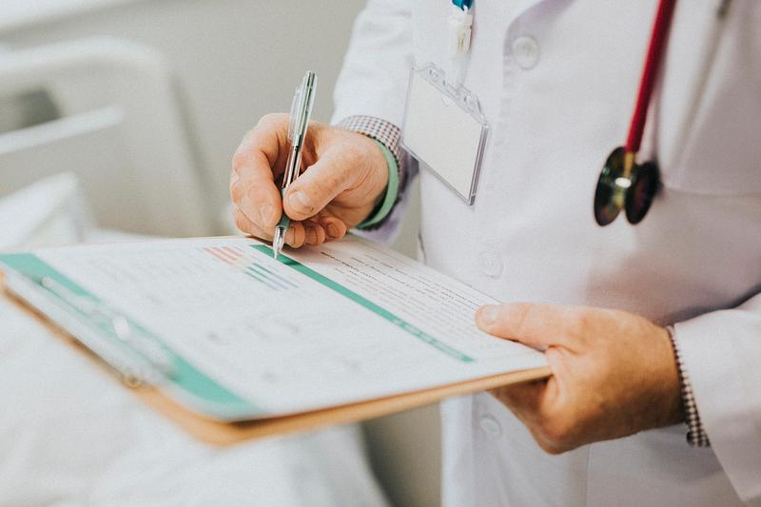

Project Overview
Overview of Health Disease Detection and its importance
Challenges in early diagnosis and healthcare limitations.
Aim to develop an AI-based system for efficient disease detection.
Data collection, feature selection, model training, and evaluation.
Machine learning, deep learning, Python, TensorFlow.
Improved diagnosis accuracy and faster detection.
Benefits for doctors, researchers, and patients with better healthcare solutions.
Expansion into predictive analytics and AI-driven diagnostics.
Notes:
New Courses replaced with New Programmes

Slide 4
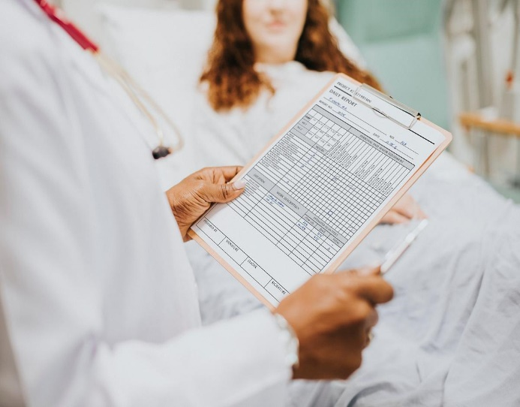

About the Problem
Problems Identified:- Many disease are detected too late, leading to severe health issues . Misdiagnosis , lack of doctors in remote areas , high costs, data overload.
Issues or Problems:-AI disease detection must be accurate, secure, and unbiased.
Need of Solution:-A smart, affordable, and accessible disease detection system can improve early diagnosis, reduce errors, lower costs, and help doctors make better decisions.
Existing Solution:-AI-powered medical imaging (Google DeepMind), wearable health trackers (Apple Watch), reading reports(X-Ray, Ultrasound, City scan so on……)
Notes:
New Courses replaced with New Programmes

Slide 5
Problem Statement
Many diseases are detected too late due to misdiagnosis, lack of healthcare access, and high costs. This delay leads to severe health complications and higher mortality rates.
Early detection saves lives, improves treatment success, reduces medical costs, and makes healthcare accessible to remote areas. AI-based detection can support doctors and enhance accuracy.
Solving this problem leads to better health outcomes, reduced hospital burden, improve acknowledge about existence disease.
Notes:
New Courses replaced with New Programmes

Slide 6
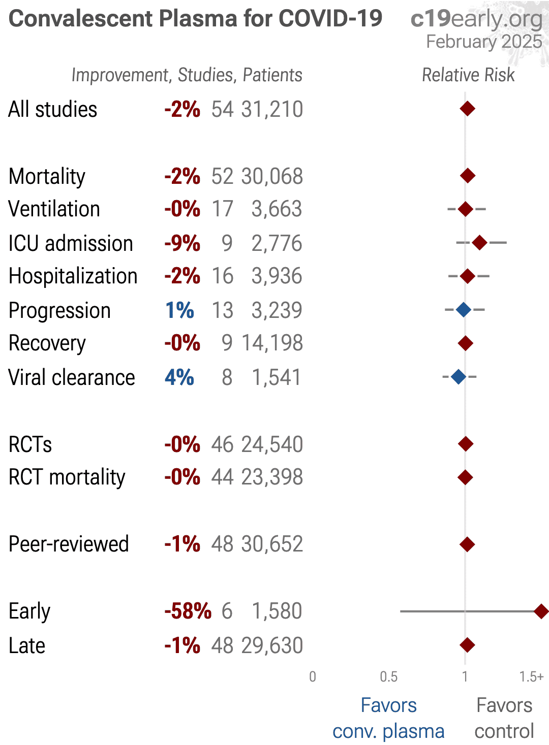
Objectives
Data Collection & Preprocessing: Gather and clean health data.
Feature Selection: Identify key factors influencing disease.
Model Development: Train machine learning models for disease prediction.
Evaluation: Assess model performance (accuracy, precision, etc.).
Deployment & Monitoring: Deploy and continuously improve the model.
Notes:
New Courses replaced with New Programmes

Slide 7
Methodology, Tools, and Techniques
The project follows a systematic approach that includes data collection, preprocessing, feature selection, and machine learning model training to detect diseases accurately. AI models are trained using patient data and symptoms to predict potential health conditions.
Tools, Software, and Techniques Used
Programming Languages – Python (NumPy, Pandas, Matplotlib)
Machine Learning Frameworks – TensorFlow, Scikit-learn, PyTorch
Data Processing & Analysis – Jupyter Notebook, SQL, Excel
Deployment – APIs, Flask/Django
Visualization – Tableau, Power BI for analyzing results
Justification for Chosen Methods
Machine Learning models improve accuracy in disease prediction.
Deep Learning techniques handle complex medical data efficiently.
Deployment ensures accessibility and scalability.
Data visualization helps in better interpretation and decision-making.
Automation speeds up diagnosis and reduces human error.
Notes:
New Courses replaced with New Programmes

Slide 8
Methodology Flowchart
start
Name
Enrollment
Age
Data retrieved
contact
Input patient report
Analyzation of report
Disease identfied
Notes:
New Courses replaced with New Programmes

Slide 9
Project Timeline
Gantt chart or timeline graph
Breakdown of project phases
Estimated duration for each phase
Notes:
New Courses replaced with New Programmes

Slide 10
Expected Results & Impact
Expected Results
Accurate Disease Prediction – AI-driven analysis will improve early detection accuracy.
Efficient Diagnosis Process – Faster and automated analysis reduces the burden on healthcare professionals.
Prototype or Simulation – A working AI-based model for symptom analysis and disease prediction.
Real-Time Health Monitoring – Integration with wearable devices for continuous patient tracking.
Impact
Healthcare Advancement – Enhances early detection, reducing severe complications.
Benefit to Medical Researchers – Provides insights into disease trends and risk factors.
Industry Applications – Can be integrated into telemedicine, hospitals, and insurance services.
Future Scope – Expansion into predictive analytics and AI-driven diagnostics.
Notes:
New Courses replaced with New Programmes

Slide 11
References
Health Quest Diagnostic.com
Scan4health.in
Healthindialab.com
Notes:
New Courses replaced with New Programmes

Slide 12
Instructions
No ChatGPT direct generated text, It can be used for improvements.

Slide 13
THANK YOU

